Slide 1
Software System Design CS20006
Lecture 4
Design Paradigms

Slide 2
Function-Oriented Design

Slide 3
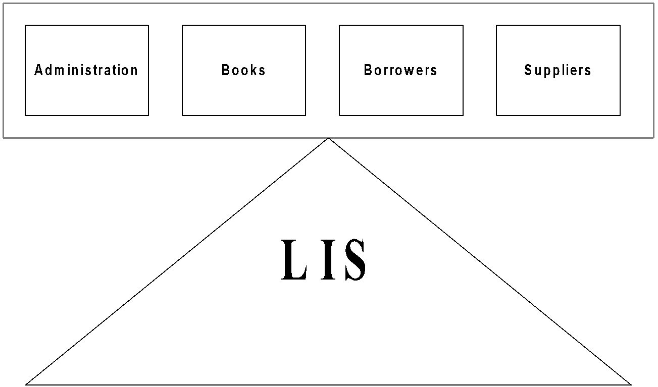
Function-Oriented Design of LIS System View
Points to be noted
Data is centralized
Several functions are there to manipulate centralized data
Functions are grouped together to form high level functions

Slide 4
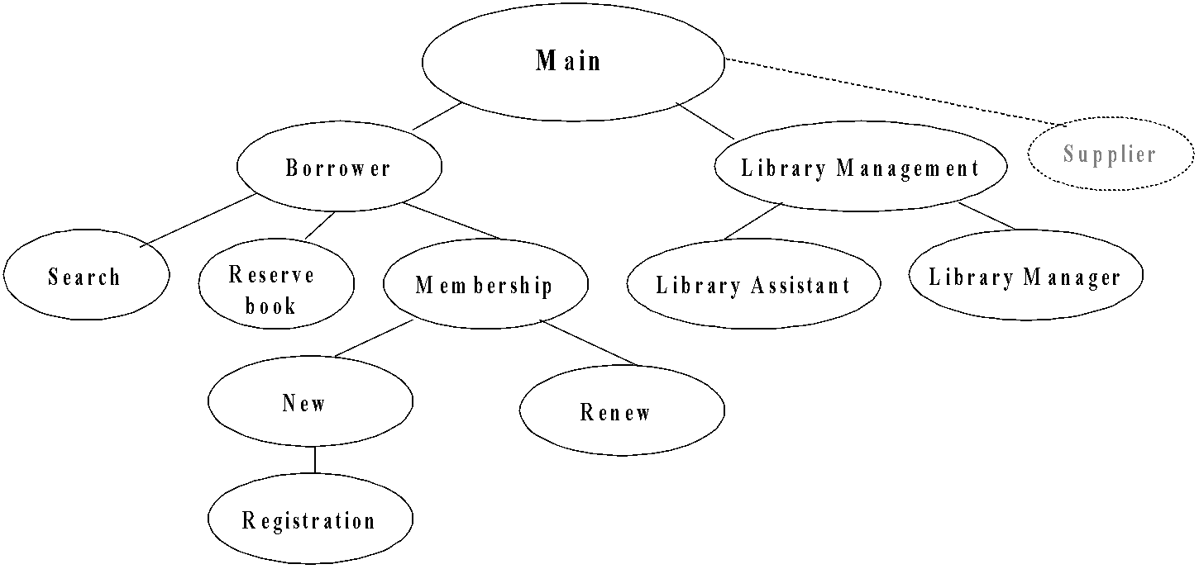
Function-Oriented Design of LIS Structural View

Slide 5
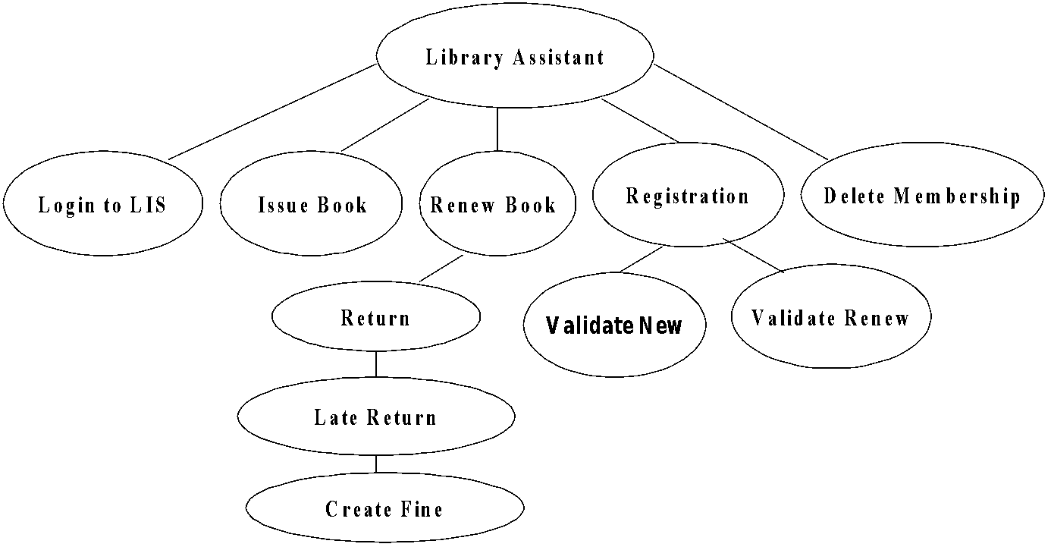
Function-Oriented Design of LIS Structural View

Slide 6
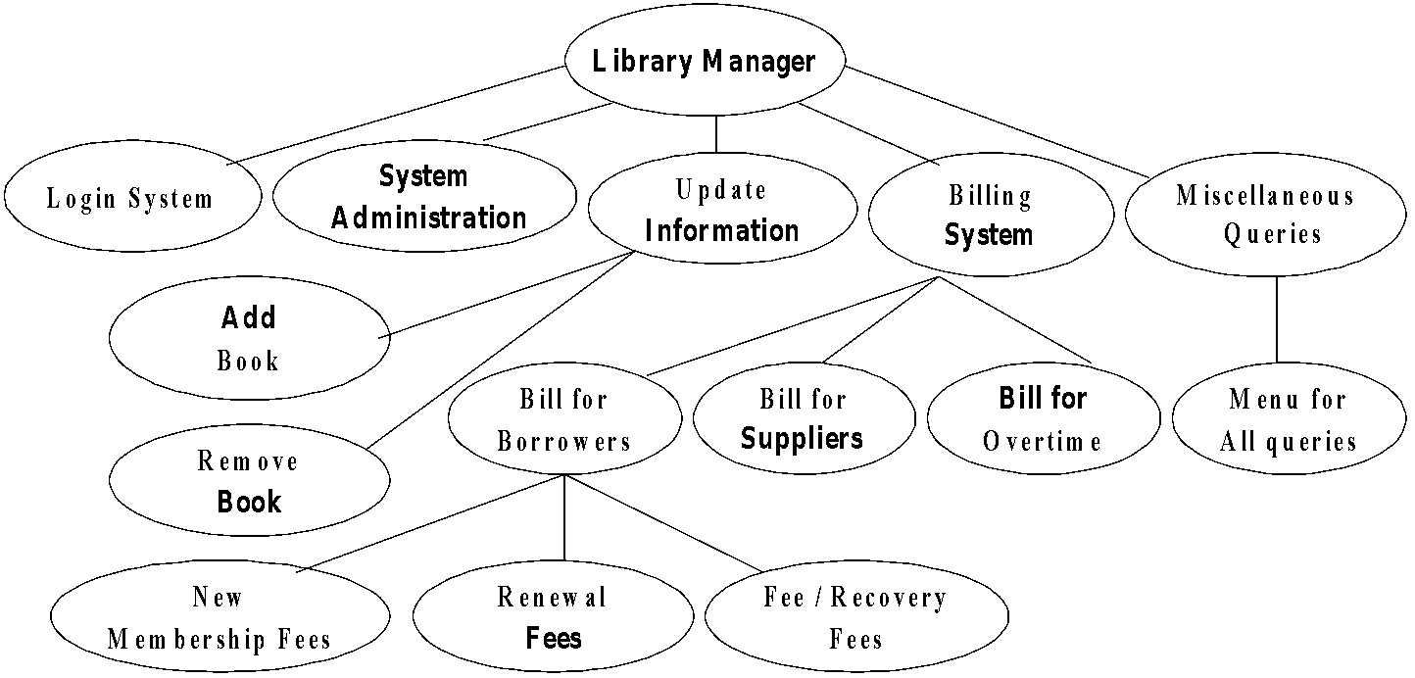
Function-Oriented Design of LIS Structural View

Slide 7
Object-Oriented Design

Slide 8
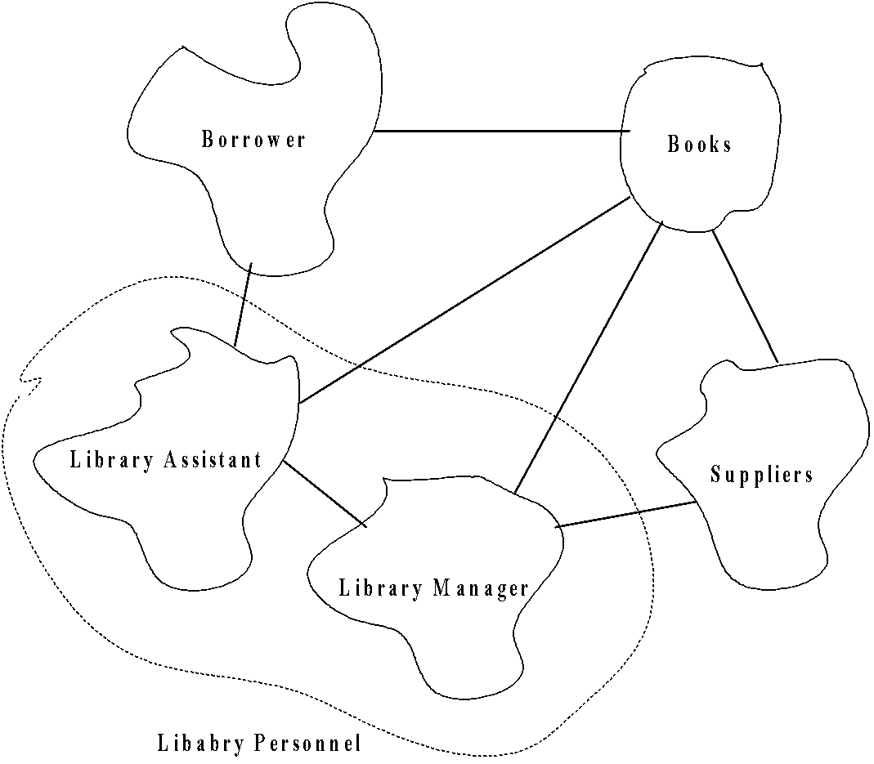
Object-Oriented Design of LIS Structural View

Slide 9
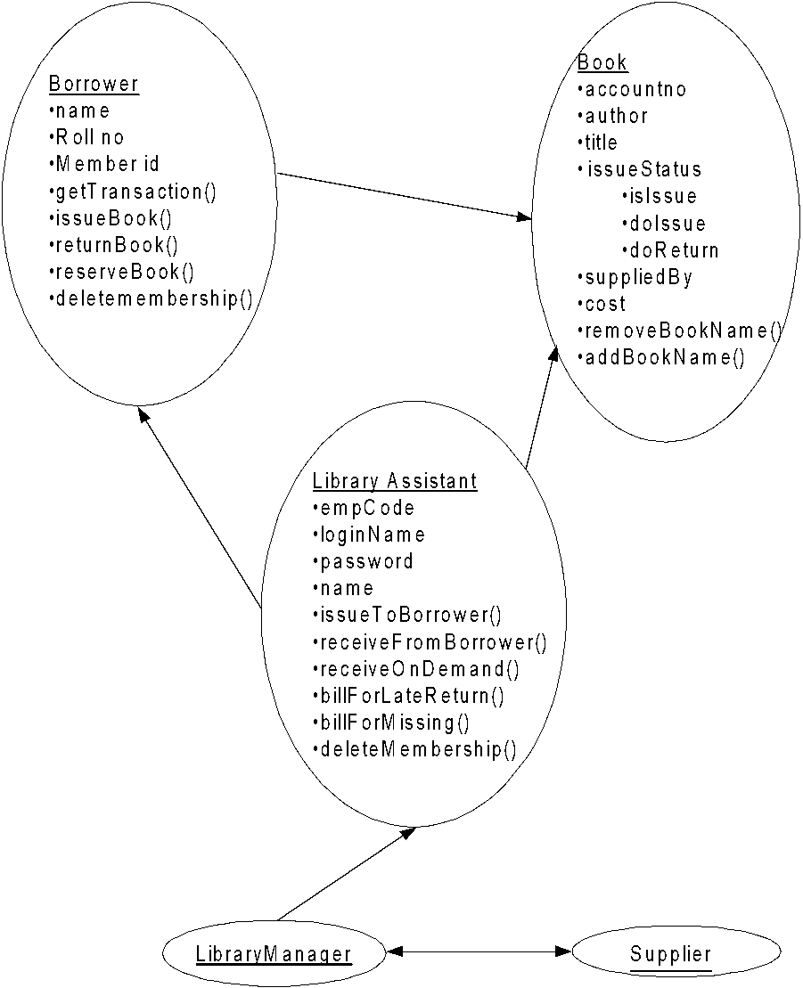
Object-Oriented Design of LIS Structural View (cont’d)

Slide 10
Object-Oriented Design of LIS
System is designed by designing objects
Objects are abstractions of real-world or system entities and manage themselves
Each object has attributes, operations
Information is not represented as a centralized store
Data and operations are grouped together

Slide 11
Problems to Ponder
How an object can be created?
What happen when an object is destroyed?
What is the basic principle of decomposing an object?
How the decompose objects are integrated?
Compare function-oriented approach and object-oriented approach
Decide parameters for comparison

Slide 12
Lecture #5
Concepts of objects
Object-Oriented Paradigms
Class
Encapsulation
Relation between classes
Association
Aggregation
Classifications
Inheritance
Delegation
Polymorphism
Dynamic Binding

Slide 13
Concepts of Objects

Slide 14
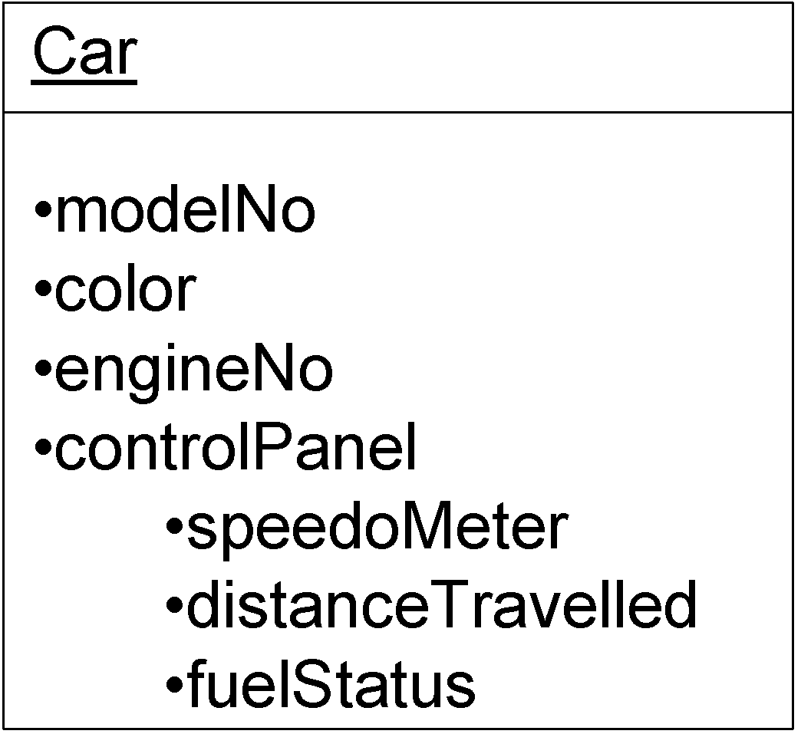
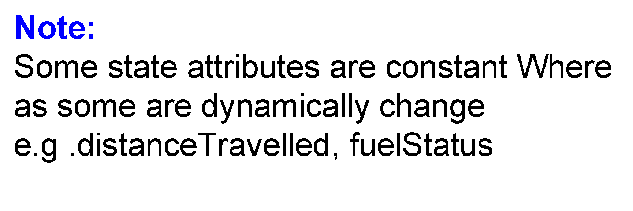
Fundamental Characteristics of Objects
Object = State + Behavior + Identity
State
The group of values of all attributes at a given point of time
e.g. Car

Slide 15
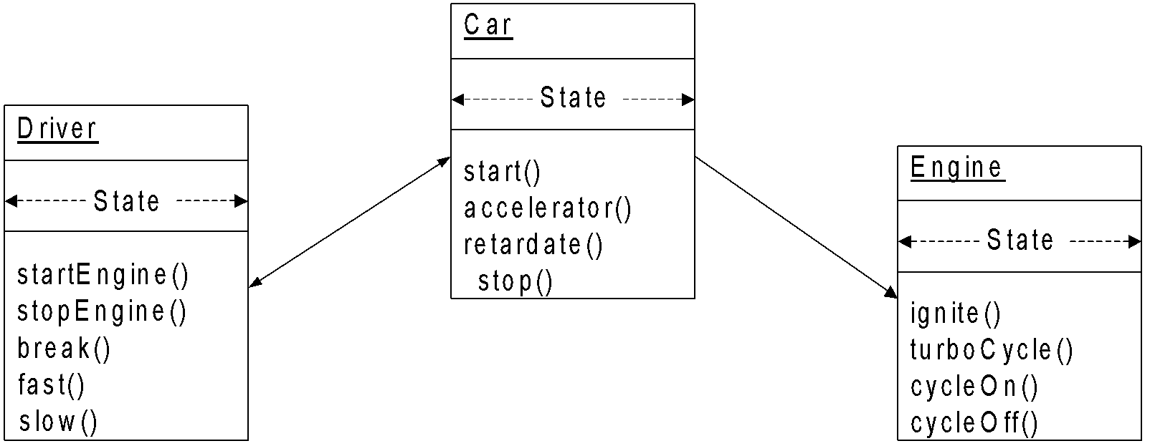
Fundamental Characteristics of Objects
Object = State + Behavior + Identity
Behavior
The group of all abilities of an object and describes the action and reaction among the objects
Note: Behavior is the means of interface between two or more objects.

Slide 16
Fundamental Characteristics of Objects
Object = State + Behavior + Identity
Identity
The characterization of its existence. The identity makes it possible to distinguish an object in an unambiguous way and independently form its group
e.g.
Car – carNo
Borrower – borrowerNo
Person – empId / voterId / rollNo

Slide 17
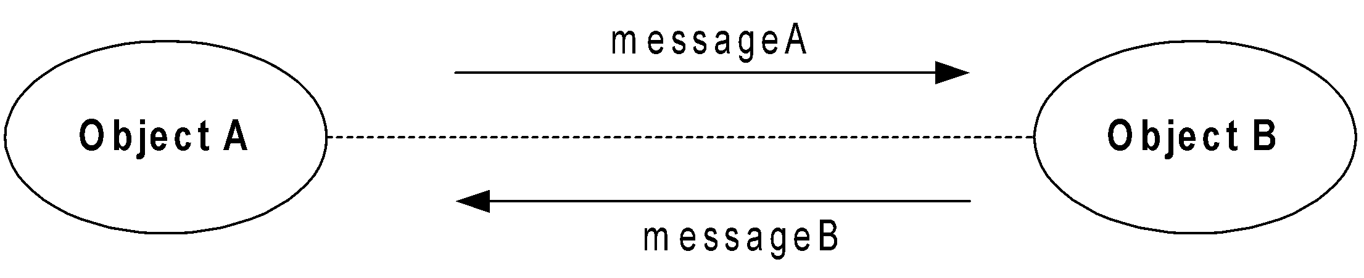
Fundamental Characteristics of Objects
Communication between two objects
Type of objects
Active objects
Passive objects
Transient/ephemeral objects
Persistent objects
Other objects categorization

Slide 18
Type of Objects
Active objects
An object is an active object if it is capable to send a message to another object
Example:
All clients are like active objects
Passive objects
An object that is not capable of sending a message to any other objects
Example:
All servers are like passive objects (however, they can reply to any message)
Transient objects
When an object constantly changes its state
Example:
Car is in motion
Persistent objects
Storing the state of objects to a permanent storage
Stores attributes of an object into a permanent storage before leaving sessions

Slide 19
Other Type of Objects
Entity objects
Objects which are related to some entities
Example:
Customer, order, book, transaction etc.
Controller Objects
Objects which control the communication of several objects
Example:
Registration Controller, Scheduler, ATM System etc.
Boundary objects
These are the objects interfaced with the system or sub-system
Example:
Database wrapper, external system etc.
Interface objects
Act as an interface between a customer and system
Example:
Registration Screen, login screen etc.

Slide 20
Object-Oriented Paradigms

Slide 21
Aim of Object-Oriented Paradigms
Real world is composed of very large number of interacting objects
Objects are abstract things than the way computer process them
Easy to understand
Easy to manipulate
Processed at higher level
Paradigm based on the concept of object reduces the gap between our way of reasoning (by abstraction) and the concept understood by computers

Slide 22
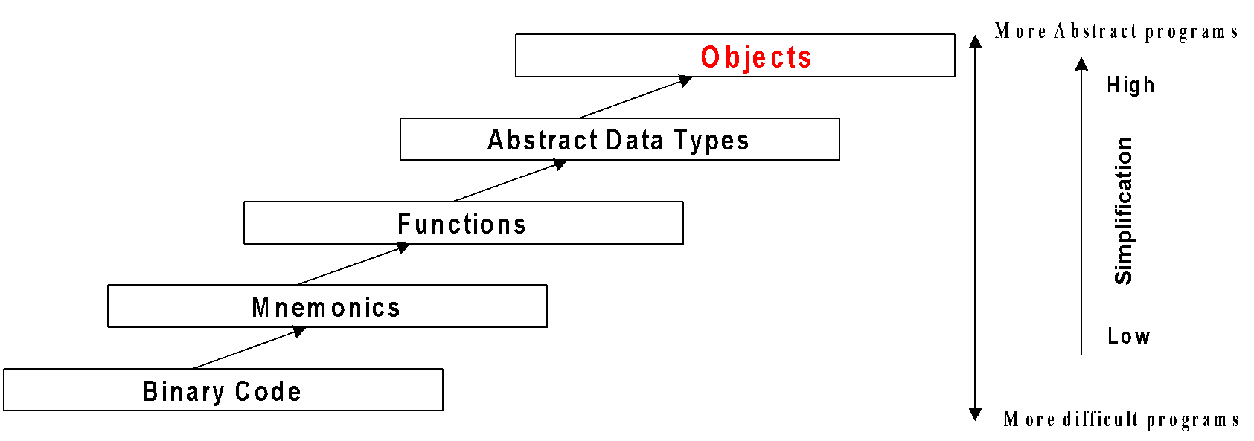
Aim of Object-Oriented Paradigms

Slide 23
Aim of Object-Oriented Paradigms
Challenges
Real world objects are too complicated to manipulate
Solution
To reduce inherent complexity object oriented paradigm have been formulated

Slide 24
Object-Oriented Paradigms
Encapsulation
Relation
Classification
Polymorphism

Slide 25
O-O Paradigms: Encapsulation
Encapsulations
Combined data and methods to manipulate data into one entity
Class is the concept of encapsulation
A varieties of objects are grouped together such as book, car, ..etc
A set of similar objects grouped together with some distinguishing structure (at a high level of abstraction)
Class is a process of abstraction

Slide 26
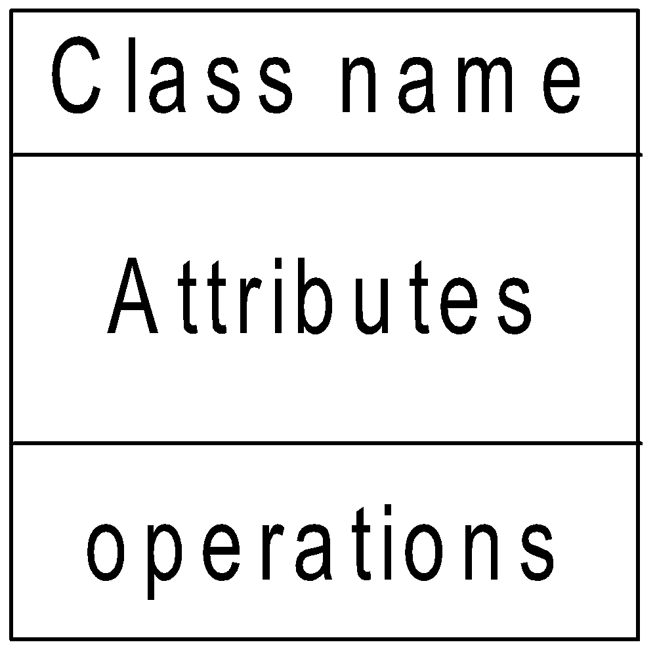
O-O Paradigms: Encapsulation
Graphical representation of a class
Example: Car
Car
modelNo
color
engineNo
controlPanel
start()
accelerate()
retardate()
Stop()

Slide 27
O-O Paradigms: Encapsulation
Exercise: Give possible class structure to the following
Set
Complex number
Rational number
TV set
Customer (of a Bank)
Account (of a customer in a Bank)
Stack/ Queue/Tree/Graph/Vector
Note: Visibility of attributes and operations
Public +
Private -
Protected #

Slide 28
O-O Paradigms: Relations
Several classes may be interrelated with each other
A relationship expresses a kind of interrelation between two classes
Two types of relationships between any two classes
Association
Aggregation

Slide 29
Relation: Association
The association relationship expresses a bi-directional, semantic connection between classes
Bi-directional
Data may flow across the association (This is unlike data flow in DFD)
Semantic connection
An association between classes means that there is a link between objects in the associated class
If an association between two objects are there then one can navigate from an object to another object in the association

Slide 30
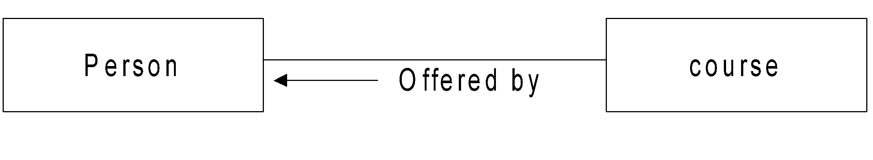
Relation: Association
Example

Slide 31
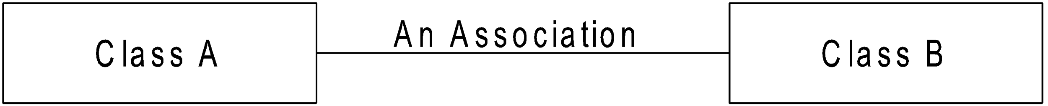
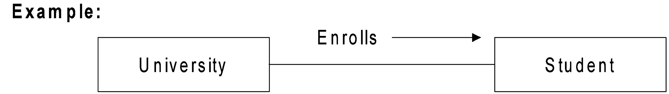
Association: Notation

Slide 32
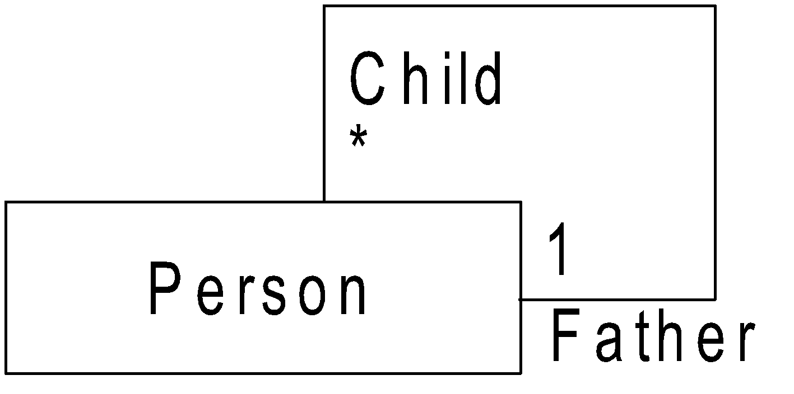
Association: Notation
Association between two classes, in general, is called binary association
It is also legal to have both ends of an association circle to back to the same class

Slide 33
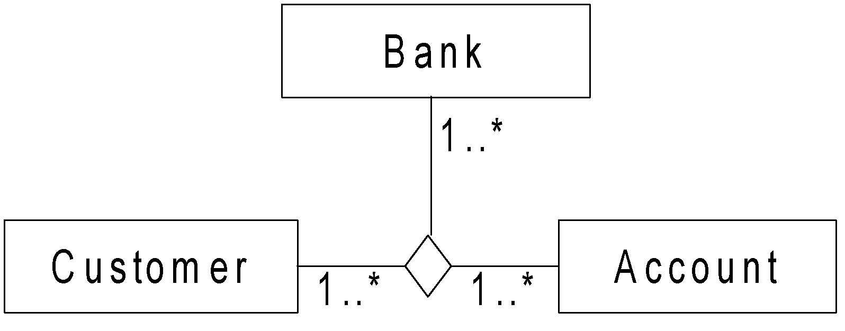
Association: Notation
n-ary association is also possible
An association having more than two classes also possible

Slide 34
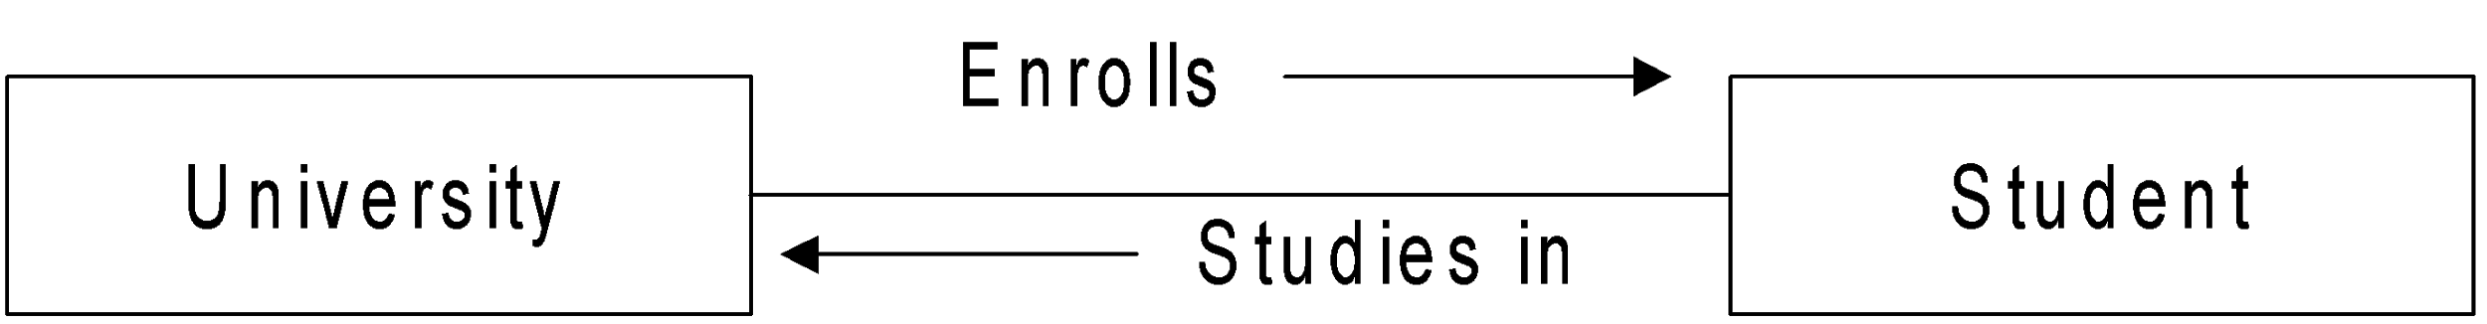
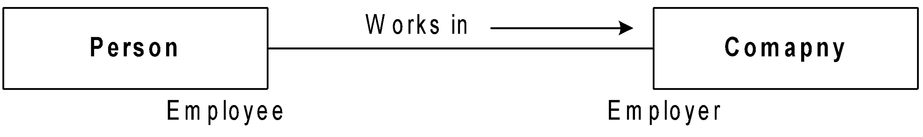
Association: Notation
More than one association may be mentioned between two classes
It is possible to specify the role of a class within an association

Slide 35
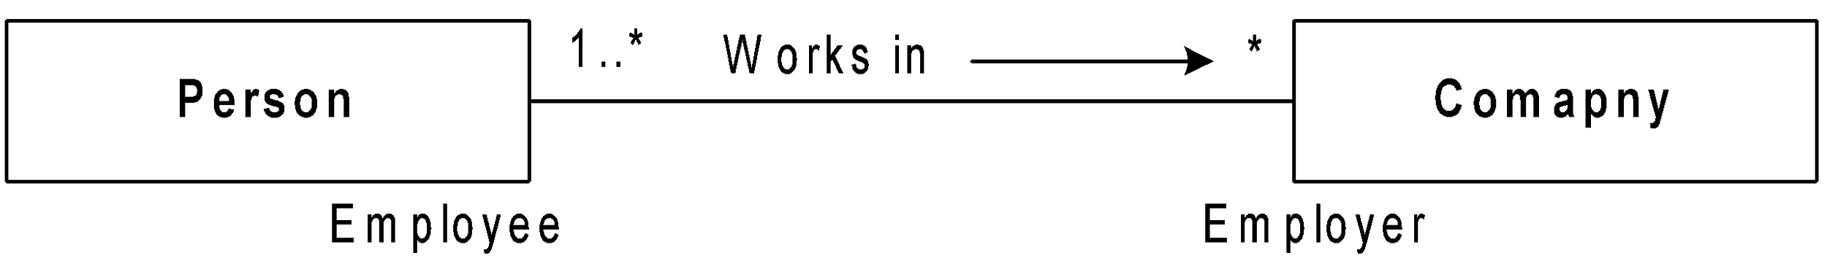
Association: Notation
A class can play more than one role at a time
Role also carry multiplicity information that specifies the number of instances that participate in a relationship
Student
Person
Register for
course
Offered by
faculty

Slide 36
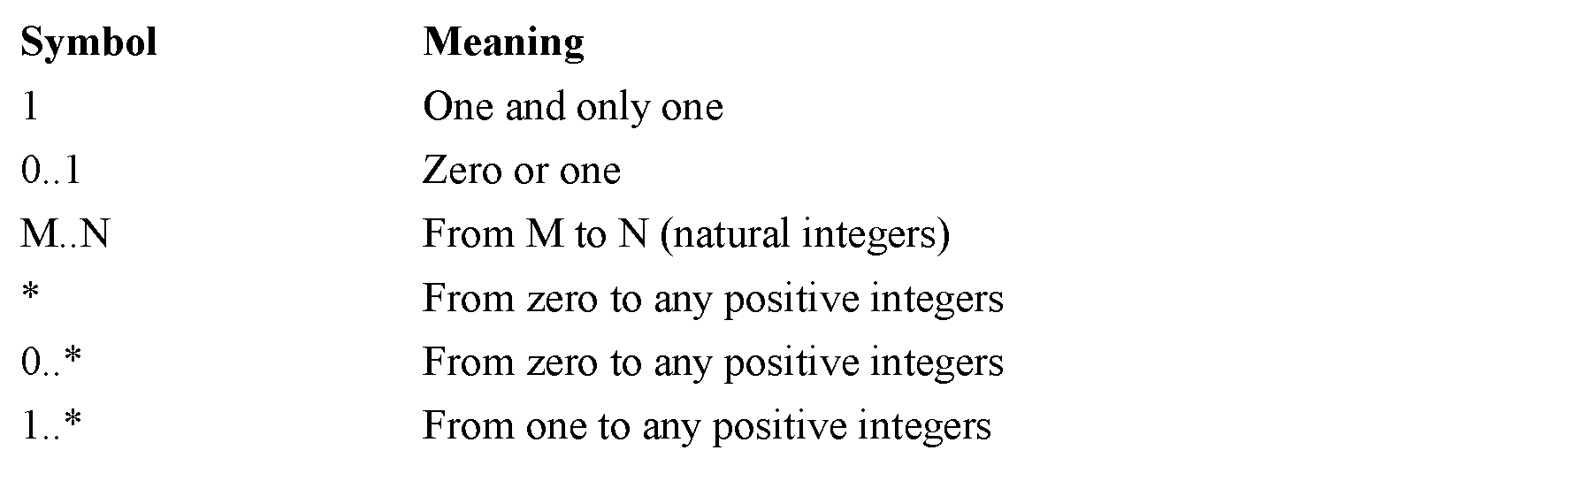
Association: Notation
Multiplicity Rules

Slide 37
Example: Multiplicity Rule
Customer may have more than one account
An account may be jointly hold by more than one customer
There are may be three types of accounts
Saving (single customer only)
Recurring (single or joint)
Current (joint only, but allow at most 5 customers)
1
saving
*
Customer
1..*
recurring
Account
*
2..5
current
*

Slide 38
Relation: Aggregation
Aggregation allows the representation of “whole/part” relationship
Whole-part relationship: one represents a large thing (the “whole”), which consists of smaller things (the “parts”)
Example
Engine is a part of Car
Also, it expresses “has a” relationship
Example
University has a number of department

Slide 39
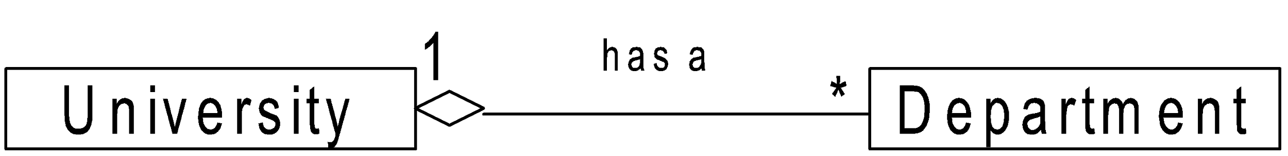
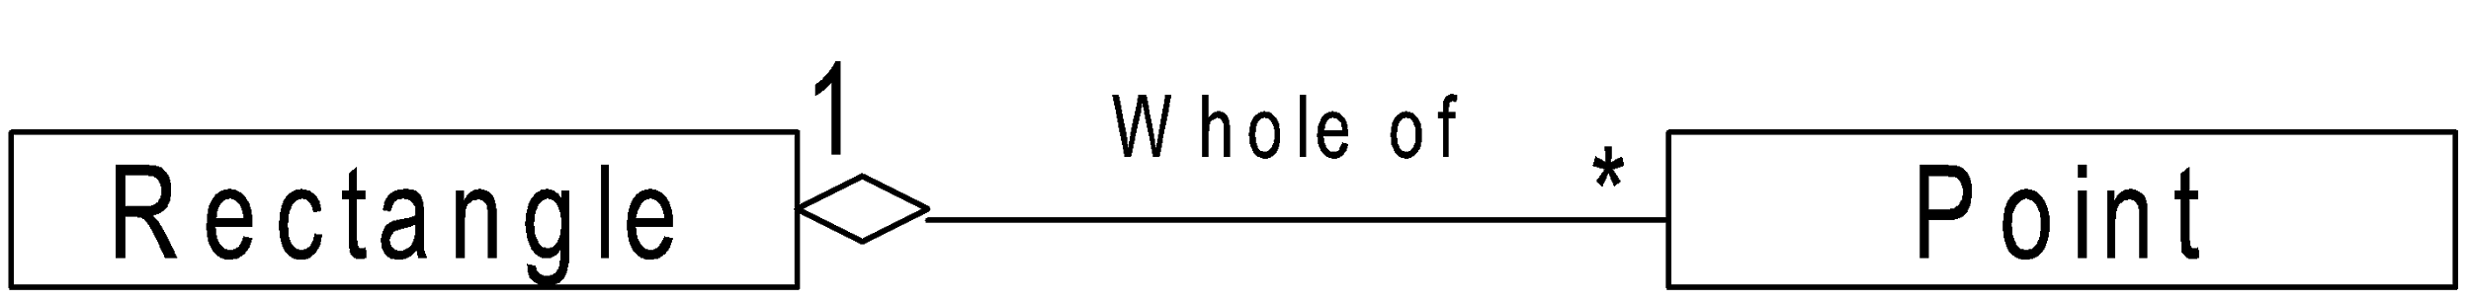
Aggregation: Notation
Meaning: B is being aggregated into A
Aggregate
Component
A
B

Slide 40
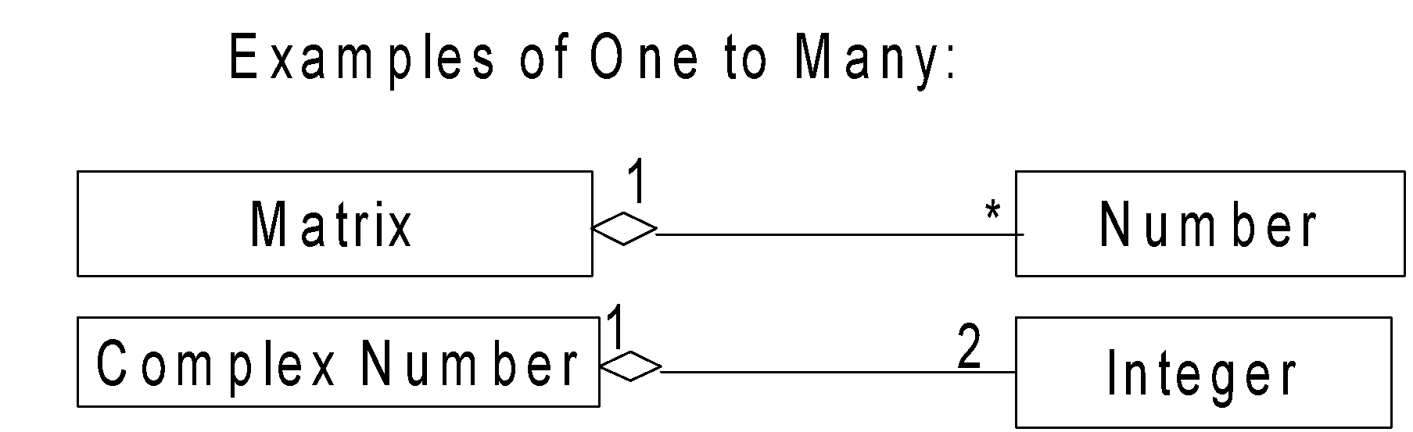
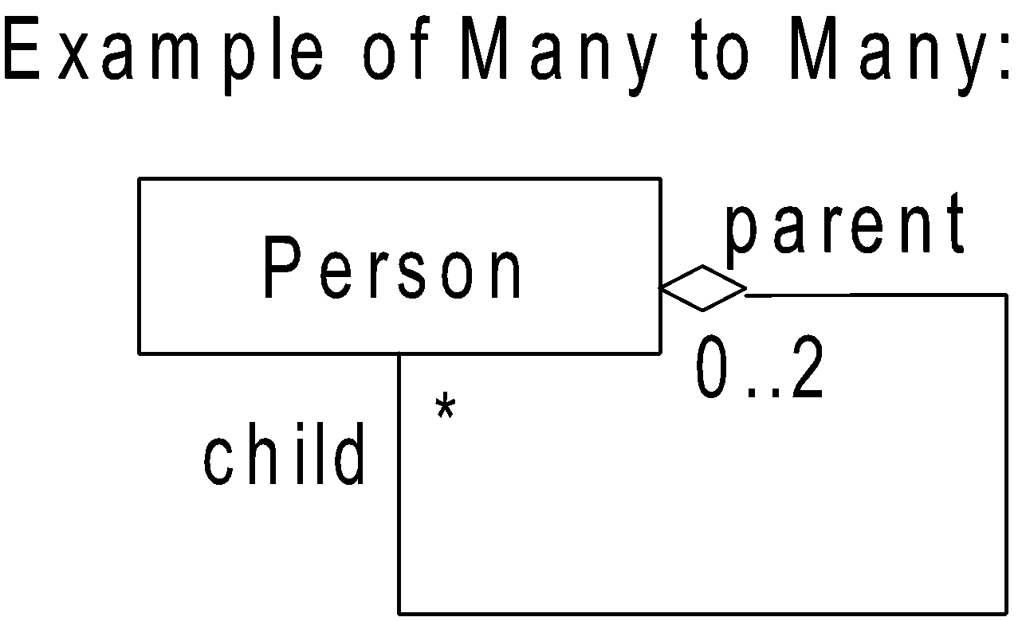
Aggregation: Notation
Aggregation represents one-to-many as well as many-to-many relations

Slide 41
Association vs. Aggregation
Association represents structural relationships between peers, meaning that both classes are at same level
Aggregation represents a “master and slave” relationship between two classes
Class
1 follows
*
Course
Class
1 contains
*
Students

Slide 42
Association vs. Aggregation
The following tests may be used to determine if a relation is an association or an aggregation
Is the phase “part” describe the relationship?
1
Rectangle
*
Point
University
*
Department

Slide 43
Association vs. Aggregation
The following tests may be used to determine if a relation is an association or an aggregation
Are some operations on the whole automatically applied to its parts?
Class
1 contains
*
Student
If delete a class then all of its student also deleted

Slide 44
Association vs. Aggregation
The following tests may be used to determine if a relation is an association or an aggregation
Is there any intrinsic asymmetry to the relationship where one class is subordinate to the other?
Set
1
*
Element

Slide 45
Association vs. Aggregation
Truly, Aggregation is a special kind of Association
Association: is-a relationship with weak coupling
Aggregation: is-a relationship with strong coupling
Association: bi-directional and symmetric connection between classes
Aggregation: bi-directional and asymmetric connection between classes

Slide 46
Association vs. Aggregation
A good heuristic test for whether a relationship is an aggregation is to ask
If the part moves, can one deduce that the whole moves with it?
People
Is the MD
Company
Car
1
1
Engine

Slide 47
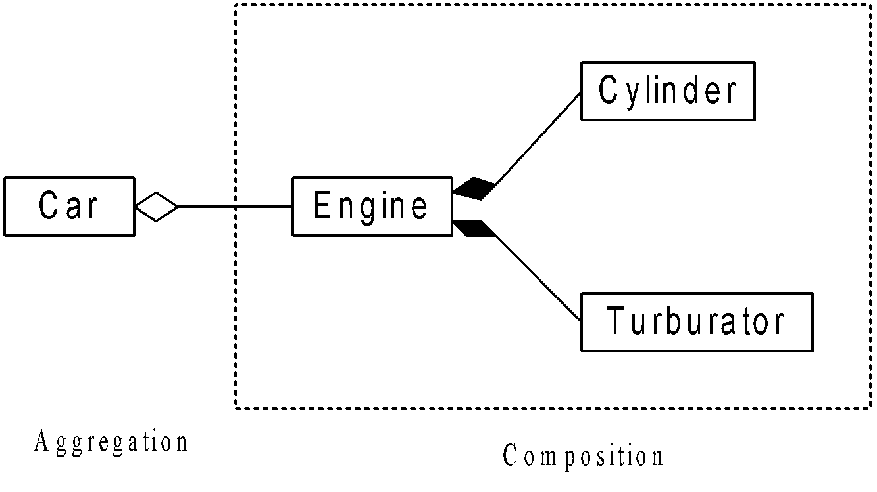
Composition
Composition is a special case of aggregation
Attributes are particular case of aggregation
Attributes are physically contained in the aggregate
Example:

Slide 48
O-O Paradigms: Classification
Class hierarchies (or classification) makes it possible to manage complexity by ordering the objects within trees or classes, with increase level of abstraction
Generalization and specialization are the two point of views that are based on class hierarchy
More Generalized
class
Super class
Generalization
Specialization
More Specialized
class
Sub class

Slide 49
Classification: Generalization
Generalization consists of factoring common elements (attributes, operations) within the set of classes into more general class called super class
A new class (sub class) can be derived from the super class with some additional features in addition to the features in the super class
Super class is an abstraction of its sub classes. Alternately, sub class is a detailed version than that of super class

Slide 50
Generalization: An Example
More General Abstraction
General Abstraction
Vehicle
Land Vehicle
Water Vehicle
Air Vehicle
Car
Truck
Ship
Stemmer
Helicopter
Plane
Extension by Specialization

Slide 51
Classification: Specialization
Specialization allows the capture of the specific features of a set of objects that have not been distinguished by the classes already identified
The characteristics are represented by a new class , which is a subclass of the one of the existing classes
More Generalized
class
Super class
Generalization
Specialization
More Specialized
class
Sub class

Slide 52
Classification with Relations
Examples: Classification with Association
appearance
Butterfly
Stage
Larva
Caterpillar
Adult
appearance
Person
Stage
Child
Young
Adult

Slide 53
Classification with Relations
Example: Classification with Aggregation
1
implements
1
IEEE Member
Member Type
Student Member
Professional member
Life Member

Slide 54
Inheritance & Delegation
Inheritance is the way to implement classification
Single inheritance
Multiple inheritance
Delegation is the ability of an object to issue a message to another objects in response to a message
Delegation is an alternative to inheritance
Person
Single inheritance
Student
Employee
Multiple Inheritance
Research
Scholar

Slide 55
Inheritance: An Example
Person
name
idno
dob
getInfo()
printInfo()
Maybe a super class
Student
branch
program
grade
biodata
rollno
getRegn()
courseRegn()
Faculty
designation
doj
doPromotion
empCode
biodata
qualification
specialization
noOfResearchers
noOfProjects
updateRecord()
tourAdv()
payAdv()
Staff
designation
doj
doPromotion
empCode
biodata
updateRecord()
getLoan()
getPayslip()

Slide 56
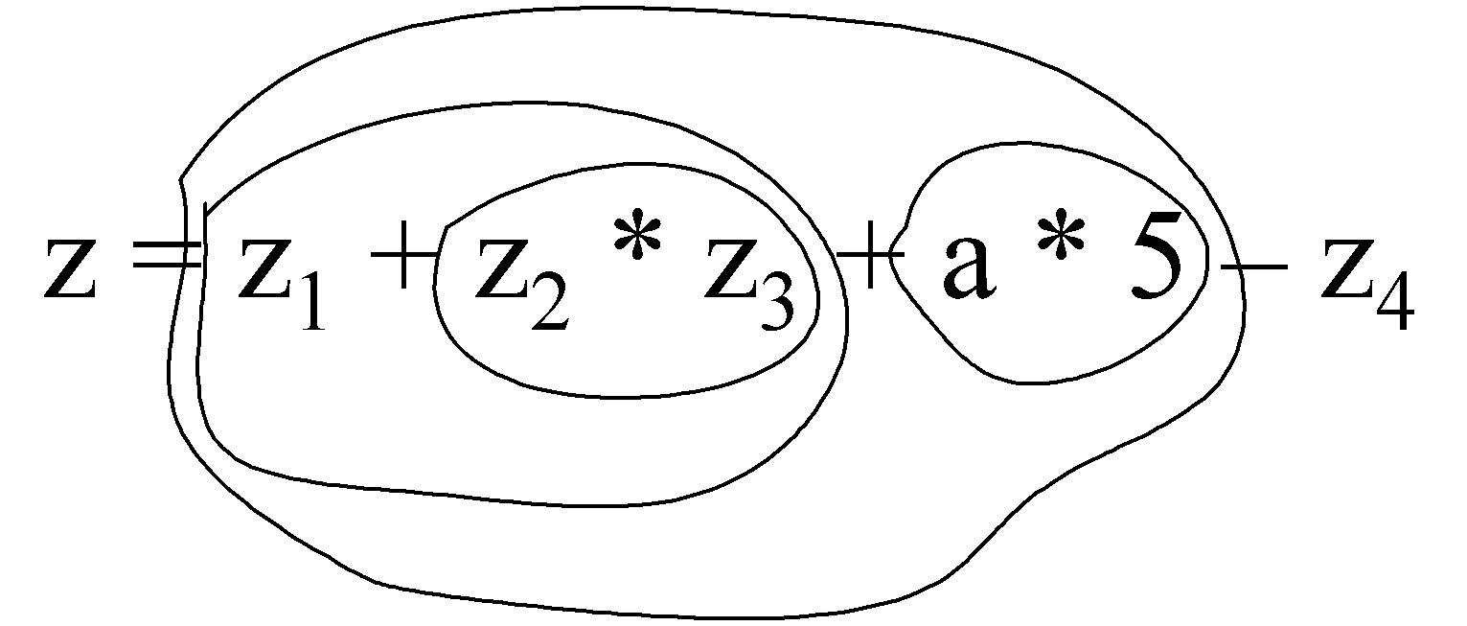
Polymorphism
Poly = many
Morphism = form
An object (as well as attributes and operations) may be viewed with many forms
Example :
Real world
Water has two forms: solid (ice) and liquid (water)
Algebra

Slide 57
Polymorphism: An Example
IEEE Member
.
.
.
.
Student
Professional
Special
.
.
.
.
.
.
.Profile()
.Profile()
.Profile()
IEEE Executive
.
.
.
.Profile()

Slide 58
Binding
Binding closely related to Polymorphism
Static binding (early binding)
Resolve during compile time
Dynamic binding (late binding)
Resolve during run time

Slide 59
Static Binding
In the case of static binding, the scope is required to be specified explicitly
In C++, Java scope resolution operator(::) is used
Example:
B1
name
display(<<name>>)
B2
name
display(<<name>>)
display(){
print “regnNo”
B1::display()
print “B2::name”
}
D
regnNo
display()

Slide 60
Dynamic Binding
B1
name
regnNo
display(){
print (name)
print (regnNo)
}
It resolve during run time
Example
In d1.display ( ): name from d1, regnNo from B
In d2.display ( ): name from D1, regnNo from D2
Note: here d1, d2 are object of D1, D2 classes respectively
D1
name
display()
D2
regnNo
enroll()

Slide 61
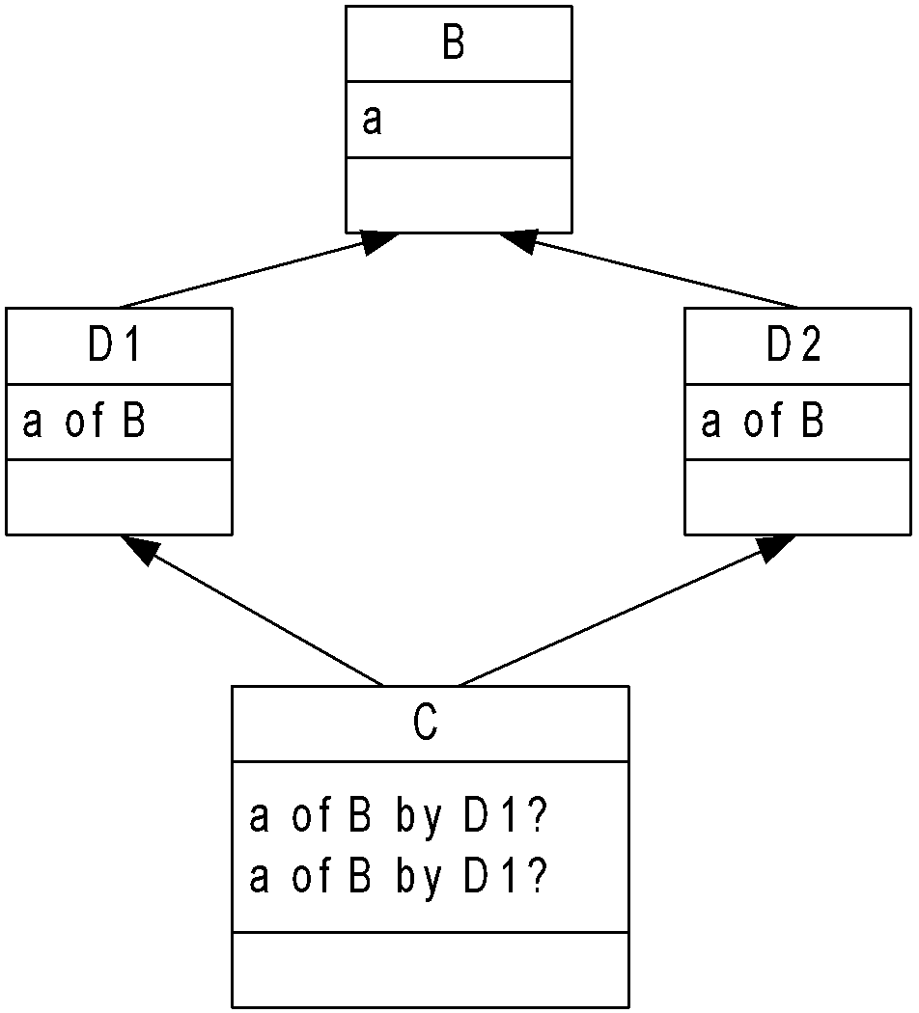
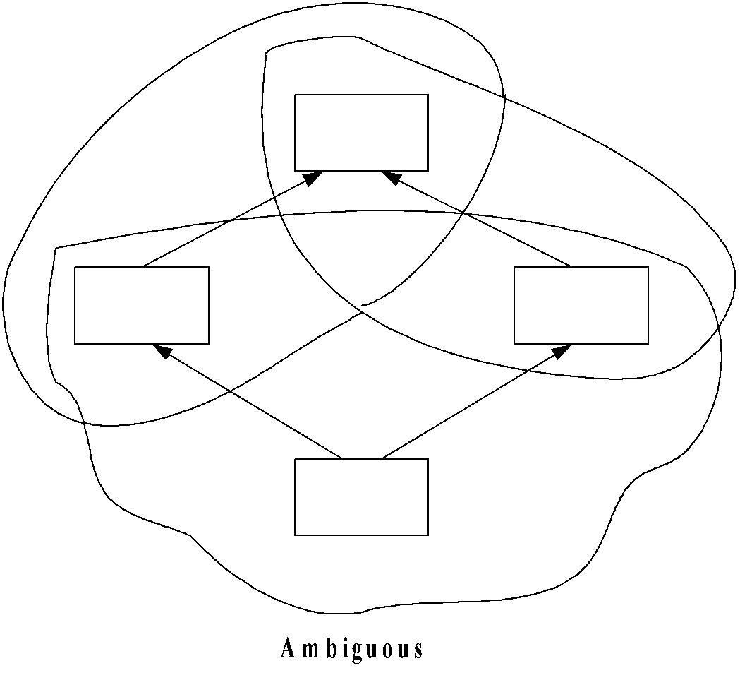
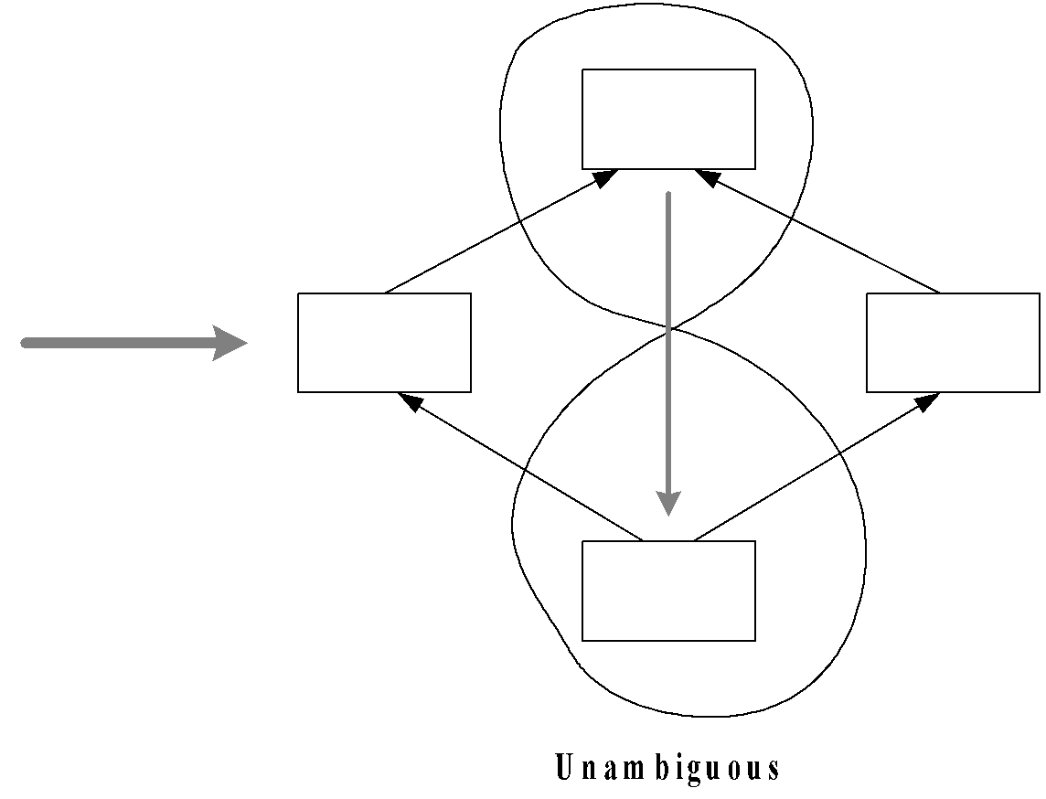
Problem to Ponder

